Slide 1
MED412 Project
By:
Dev Anand (1510110117)
Harikrishnan A (1510110148)
S M Hasan Fayaz (1510110316)
Mohammed Azharudeen (1510110486)

Slide 2
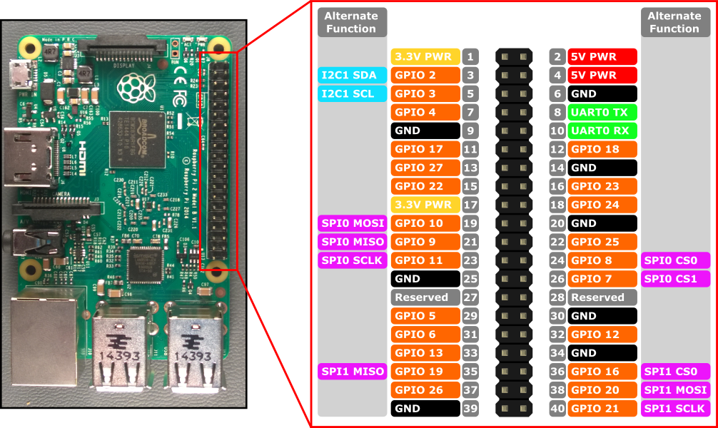
Raspberry Pie Pi3 Pin Layout

Slide 3
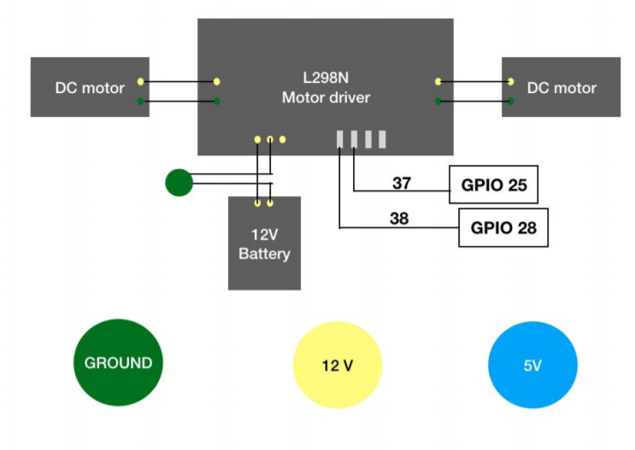
Electronics

Slide 4
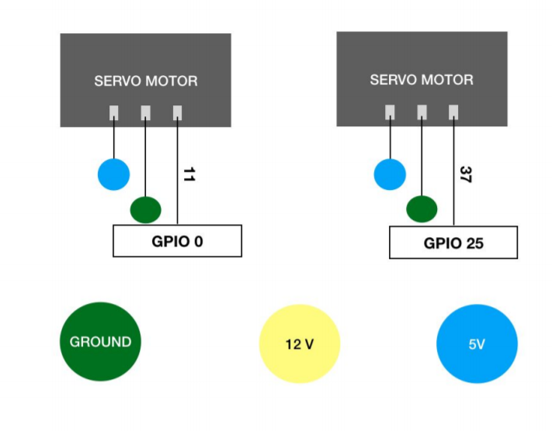
Electronics

Slide 5
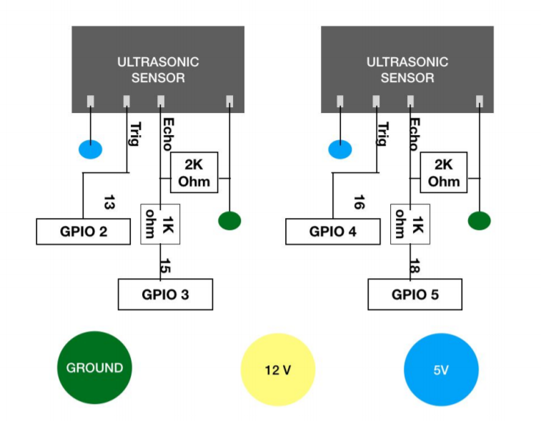
Electronics

Slide 6
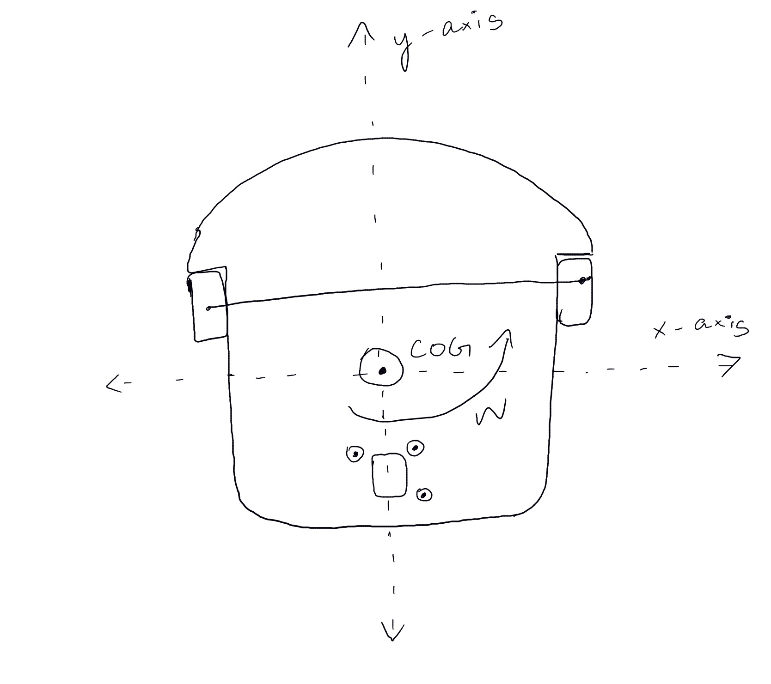
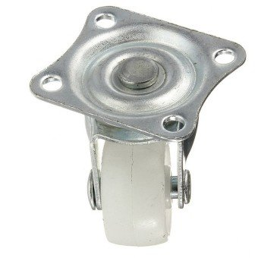
Diagram

Slide 7
Assumptions
The wheels do not slip (i.e. low angle of acceleration)
Motors are rigidly connected to the body
Negligible friction between the wheels and the ground
Turning Radius = 15 cm
Turning Speed = 150 – 200 rpm
Max w= 20.94 rad/s
R=0.03 m

Slide 8
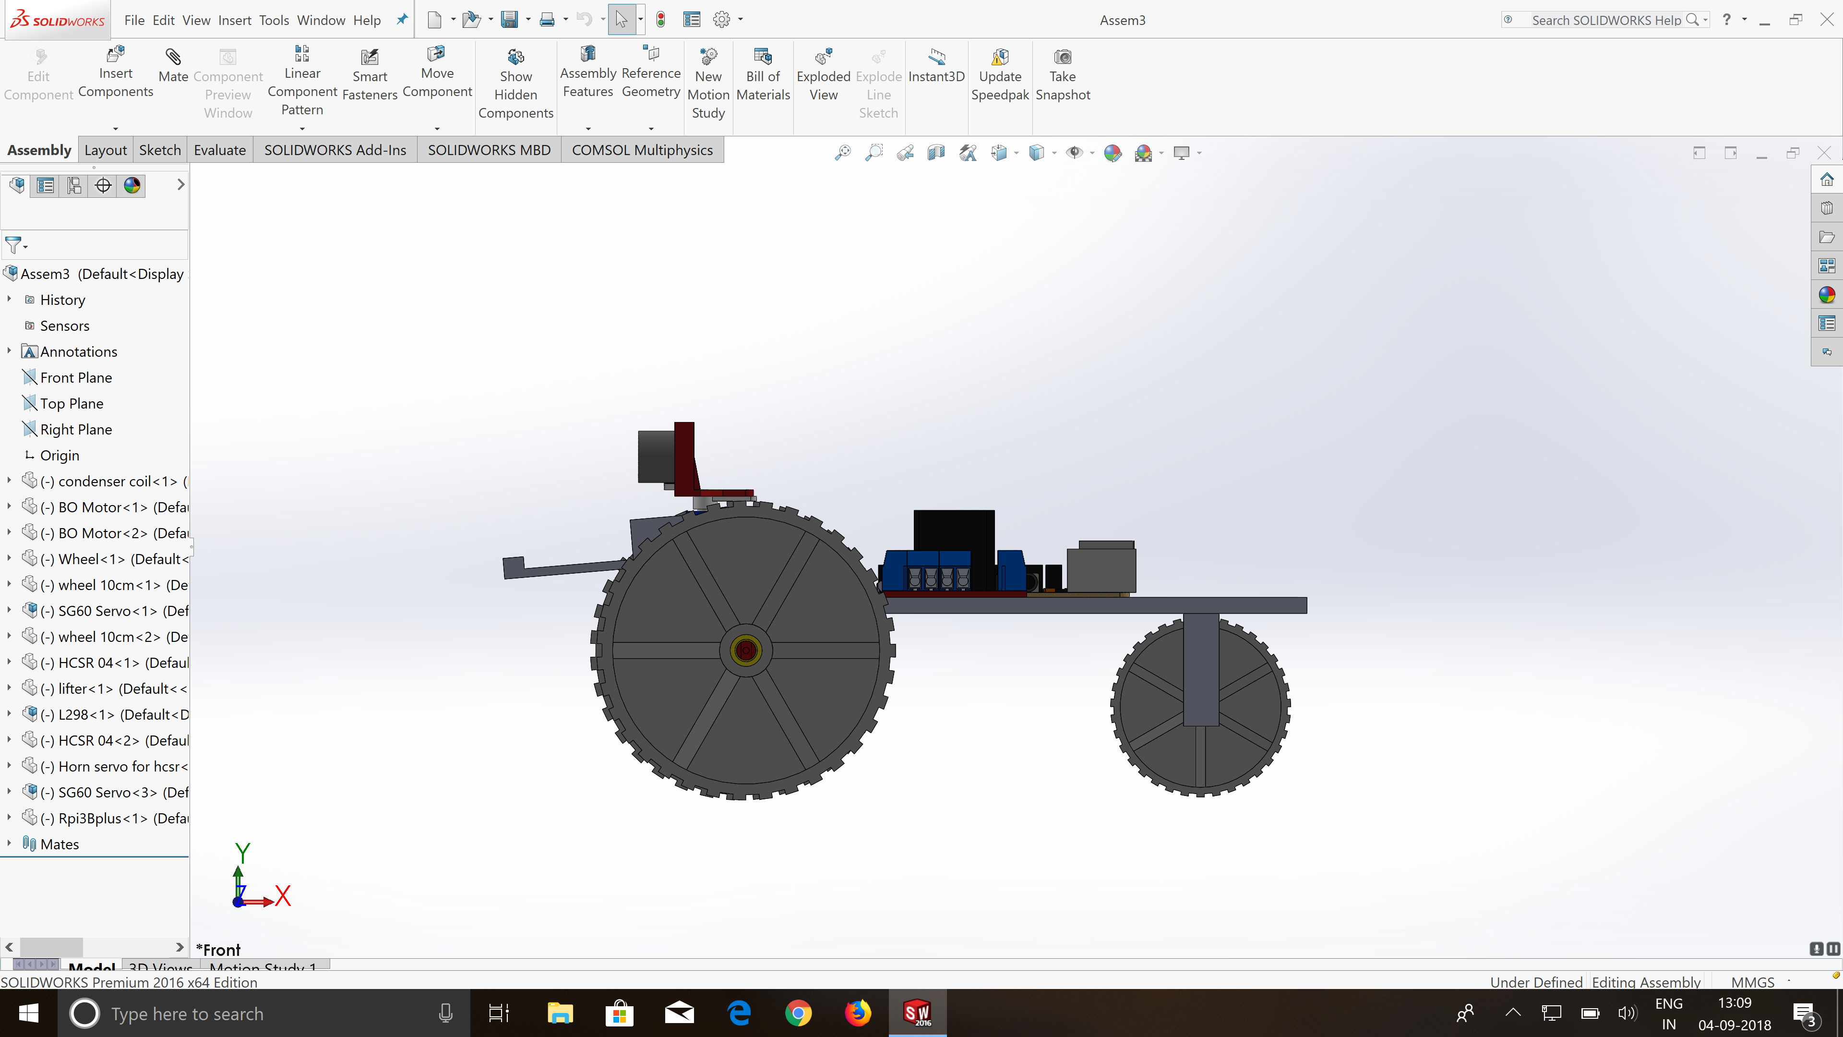
Servo:
Torque : 1.80 kg-cm
Speed : 0.12 sec/ 60 degree
Weight to be lifted ~ 200 g
Maximum arm length 9 cm
Arm length of our bot = 8 cm

